Slide 1

SECA4002 – DEEP LEARNING NEURAL NETWORKS
Dr. V. Vedanarayanan B.E., M.E., PhD
Course Co-ordinator
Assistant Professor, Department of ECE,
School of Electrical and Electronics
SATHYABAMA INSTITUTE OF SCIENCE AND TECHNOLOGY

Slide 2

Course Outcomes
SECA4002 – DEEP LEARNING NEURAL NETWORKS
At The end of this Course, Student will be able to
CO1 | Select suitable model parameters for different machine learning techniques
CO2 | Evaluate the performance of existing deep learning models for various applications
CO3 | Realign high dimensional data using reduction techniques
CO4 | Analyze the performance of various optimization and generalization techniques in deep learning
CO5 | Modify the existing architectures for domain specific applications
CO6 | Develop a real time application using deep learning neural networks

Slide 3
Course Objectives
SECA4002 – DEEP LEARNING NEURAL NETWORKS
Course Objectives:
To present the mathematical, statistical and computational challenges of building neural networks
To study the concepts of deep learning
To introduce dimensionality reduction techniques
To enable the students to know deep learning techniques to support real-time applications
To examine the case studies of deep learning techniques

Slide 4
SECA4002 – DEEP LEARNING NEURAL NETWORKS
Detailed Syllabus:
UNIT 4: OPTIMIZATION AND GENERALIZATION
Optimization in deep learning– Non-convex optimization for deep networks- Stochastic Optimization Generalization in neural networks- Spatial Transformer Networks- Recurrent networks, LSTM Recurrent Neural Network Language Models- Word-Level RNNs & Deep Reinforcement Learning - Computational & Artificial Neuroscience.

Slide 5
SECA4002 – DEEP LEARNING NEURAL NETWORKS
Recommended Text Books/ Reference Books
Cosma Rohilla Shalizi, Advanced Data Analysis from an Elementary Point of View, 2015.
Deng & Yu, Deep Learning: Methods and Applications, Now Publishers, 2013.
Ian Goodfellow, Yoshua Bengio, Aaron Courville, Deep Learning, MIT Press, 2016.
Michael Nielsen, Neural Networks and Deep Learning, Determination Press, 2015.

Slide 6
Optimization In Deep Learning Network
In Deep Learning, with the help of loss function, the performance of the model is estimated/ evaluated.
This loss is used to train the network so that it performs better.
Essentially we try to minimize the Loss function .Lower Loss means the model performs better.
The process of minimizing (or maximizing) any mathematical expression is called optimization.
Optimizers are algorithms or methods used to change the features of the neural network such as weights and learning rate so that the loss is reduced.
Optimizers are used to solve optimization problems by minimizing the function
The Goal of an Optimizer is to minimize the Objective Function(Loss Function based on the Training Data set)
Simply Optimization is to minimize the Training Error

Slide 7
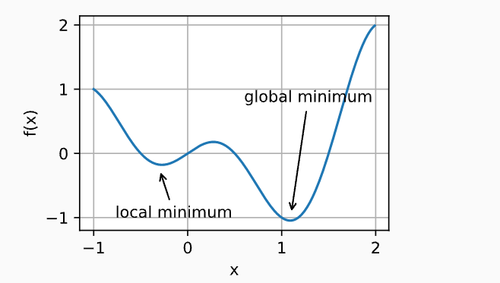
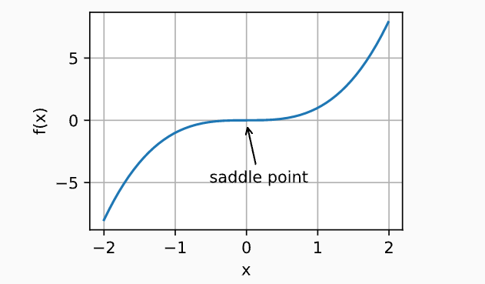
Need for Optimization In Deep Learning Network
Local Minima:
For any Objective function f(x), if the value of f(x) at x is is smaller than f(x) at any other points near x, f(x) is termed as local minimum. If f(x) at x is minimum over the entire region then its called global minimum.
The objective function of deep learning models usually has many local optima.
SADDLE POINT :
saddle points are another reason for gradients to vanish. A saddle point is any location where all gradients of a function vanish but which is neither a global nor a local minimum

Slide 8
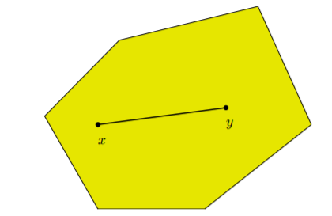
Need for Optimization In Deep Learning Network
Need for optimization:
To reduce Local Minima
To avoid Vanishing Gradients or Exploding Gradients
To select appropriate weight values and other associated model parameters
To minimize the loss value (Training error)
Convex Optimization:
Convex optimization is a kind of optimization which deals with the study of problem of minimizing convex functions .
Here the optimization function is Convex function..
All Linear functions are convex, so linear programming problems are convex problems
When we have a convex objective and a convex feasible region, then there can be only one optimal solution, which is globally optimal.
Definition: A set C ⊆ Rn is convex if for x, y ∈ C and any α ∈ [0, 1],
αx + (1 − α)y ∈ C

Slide 9
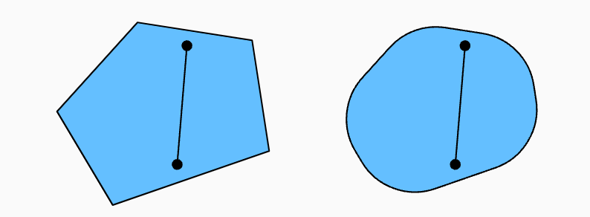
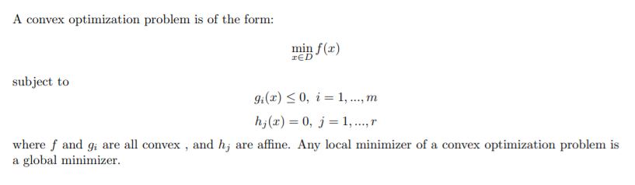
Convexity
Convexity plays a vital role in the design of optimization algorithms. This is largely due to the fact that it is much easier to analyze and test algorithms in such a context.
Select any to points in the region and join them by a straight Line. If the line and the selected points all lie inside the region then we call that region as Convex Region (as Shown in the diagram)

Slide 10
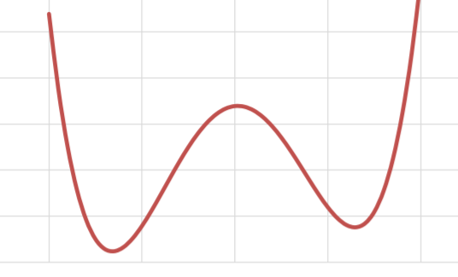
Non-Convex Optimization
Non Convex Optimization: The objective function is a non convex function.
It has Multiple feasible regions and multiple locally optimal points.
There can’t be a general algorithm to solve it efficiently in all cases
Neural networks are universal function approximators, To do this, they need to be able to approximate non-convex functions.
Non Convex Region
How to solve non-convex problems?
Stochastic gradient descent
Mini-batching
SVRG
Momentum
Reasons For Non Convexity:
Presence of many Local Minima
Prescence of Saddle Points
Very Flat Regions
Varying Curvature

Slide 11
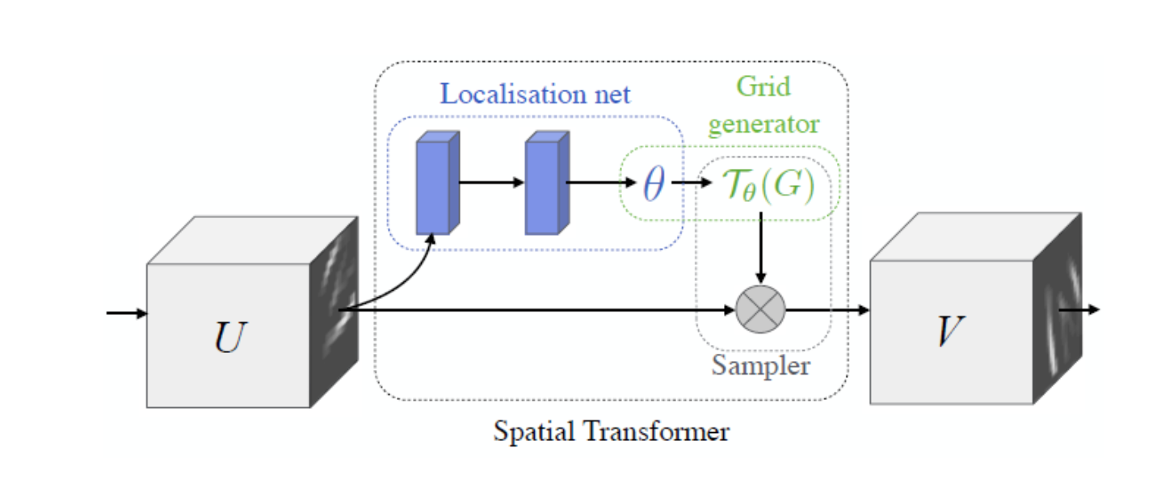
Spatial Transformer Networks
Spatial Transformer Network (SSTN) helps to crop out and scale-normalizes the appropriate region, which can simplify the subsequent classification task and lead to better classification performance

Slide 12
Spatial Transformer Networks
STN is composed of Localization Net, Grid Generator and Sampler.
Localisation Net
With input feature map U, with width W, height H and C channels, outputs are θ, the parameters of transformation Tθ. It can be learnt as affine transform
Grid Generator
Suppose we have a regular grid G, this G is a set of points with target coordinates (xt_i, yt_i).
Then we apply transformation Tθ on G, i.e. Tθ(G).
After Tθ(G), a set of points with destination coordinates (xt_i, yt_i) is outputted. These points have been altered based on the transformation parameters. It can be Translation, Scale, Rotation or More Generic Warping depending on how we set θ as mentioned above.
Sampler
Based on the new set of coordinates (xt_i, yt_i), we generate a transformed output feature map V. This V is translated, scaled, rotated, warped, projective transformed or affined, whatever.
It is noted that STN can be applied to not only input image, but also intermediate feature maps.

Slide 13
Spatial Transformer Networks
STN is a mechanism that rotates or scales an input image or a feature map in order to focus on the target object and to remove rotational variance .
One of the most notable features of STNs is their modularity (the module can be injected into any part of the model) and their ability to be trained with a single backprop algorithm without modification of the initial model.
Advantages:
Helps in learning explicit spatial transformations like translation, rotation, scaling, cropping, non-rigid deformations, etc. of features.
Can be used in any networks and at any layer and learnt in an end-to-end trainable manner.
Provides improvement in the performance of existing models.

Slide 14
Recurrent Neural Networks (RNN)
RNNs are very powerful, because they combine two properties:
Distributed hidden state that allows them to store a lot of information about the past efficiently.
Non-linear dynamics that allows them to update their hidden state in complicated ways.
With enough neurons and time, RNNs can compute anything that can be computed by your computer.
RNN were created because there were a few issues in the feed-forward neural network:
Cannot handle sequential data
Considers only the current input
Cannot memorize previous inputs
The solution to these issues is the RNN

Slide 15
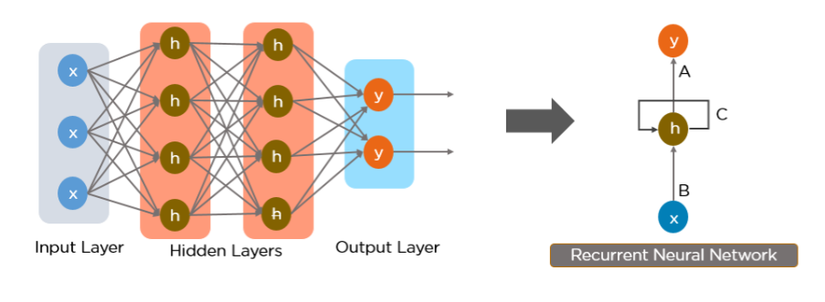
Recurrent Neural Networks (RNN)
What is a Recurrent Neural Network (RNN)?
RNN works on the principle of saving the output of a particular layer and feeding this back to the input in order to predict the output of the layer
We can convert a Feed-Forward Neural Network into a Recurrent Neural Network as below

Slide 16
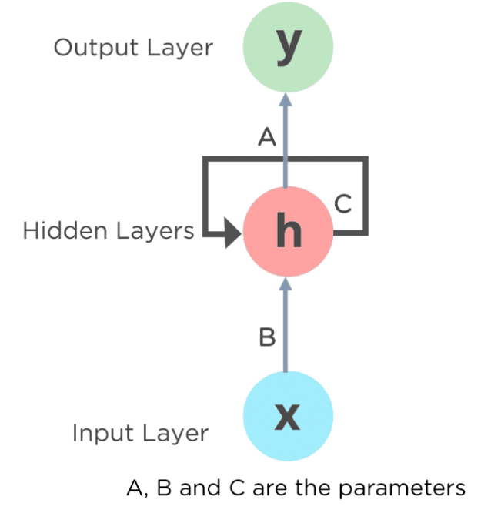
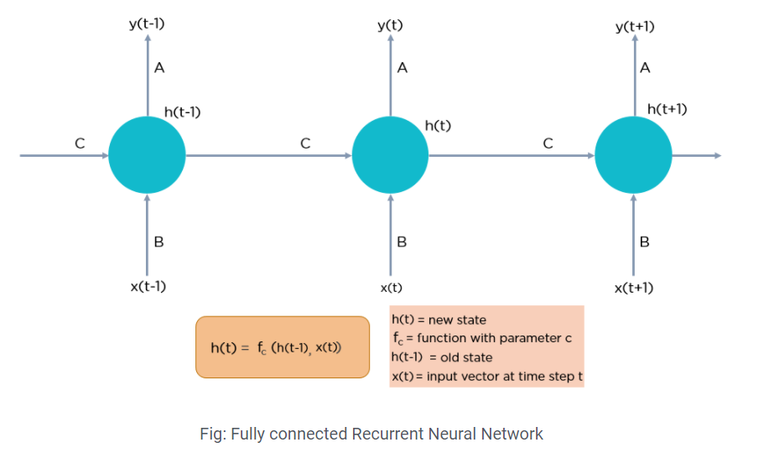
Recurrent Neural Networks (RNN)
The nodes in different layers of the neural network are compressed to form a single layer of recurrent neural networks. A, B, and C are the parameters of the network.
Here, “x” is the input layer, “h” is the hidden layer, and “y” is the output layer. A, B, and C are the network parameters used to improve the output of the model. At any given time t, the current input is a combination of input at x(t) and x(t-1). The output at any given time is fetched back to the network to improve on the output.
Image & Content: https://www.simplilearn.com/tutorials/deep-learning-tutorial/rnn#why_recurrent_neural_networks

Slide 17
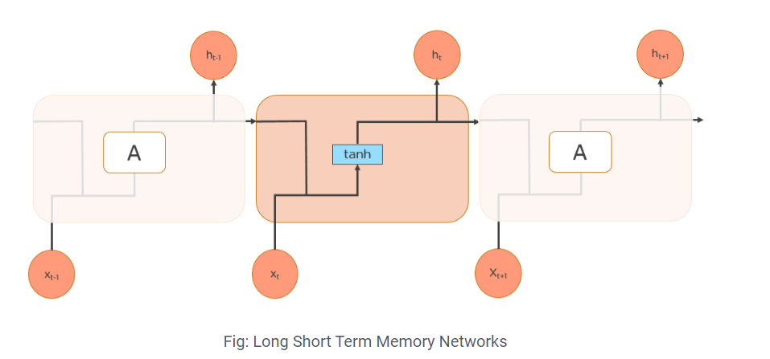
Long Short Term Memory (LSTM)
LSTMs are a special kind of RNN — capable of learning long-term dependencies by remembering information for long periods is the default behavior.
All RNN are in the form of a chain of repeating modules of a neural network. In standard RNNs, this repeating module will have a very simple structure, such as a single tanh layer.
LSTMs also have a chain-like structure, but the repeating module is a bit different structure. Instead of having a single neural network layer, four interacting layers are communicating extraordinarily.
Image & Content: https://www.simplilearn.com/tutorials/deep-learning-tutorial/rnn#why_recurrent_neural_networks

Slide 18
Long Short Term Memory (LSTM)
LSTMs are a special kind of RNN — capable of learning long-term dependencies by remembering information for long periods is the default behavior.
All RNN are in the form of a chain of repeating modules of a neural network. In standard RNNs, this repeating module will have a very simple structure, such as a single tanh layer.
LSTMs also have a chain-like structure, but the repeating module is a bit different structure. Instead of having a single neural network layer, four interacting layers are communicating extraordinarily.
Image & Content: https://www.simplilearn.com/tutorials/deep-learning-tutorial/rnn#why_recurrent_neural_networks

Slide 19
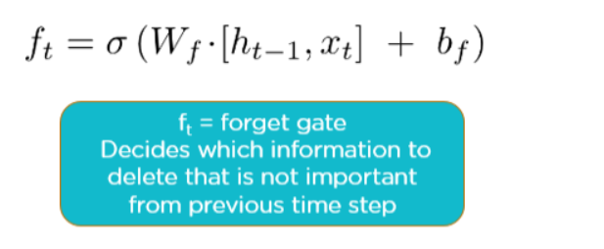
Long Short Term Memory (LSTM)
LSTMs 3-steps
Step 1: Decide how much past data it should remember
The first step in the LSTM is to decide which information should be omitted from the cell in that particular time step. The sigmoid function determines this. It looks at the previous state (ht-1) along with the current input xt and computes the function.
Step 2: Decide how much this unit adds to the current state
In the second layer, there are two parts. One is the sigmoid function, and the other is the tanh function. In the sigmoid function, it decides which values to let through (0 or 1). tanh function gives weightage to the values which are passed, deciding their level of importance (-1 to 1).
Image & Content: https://www.simplilearn.com/tutorials/deep-learning-tutorial/rnn#why_recurrent_neural_networks

Slide 20
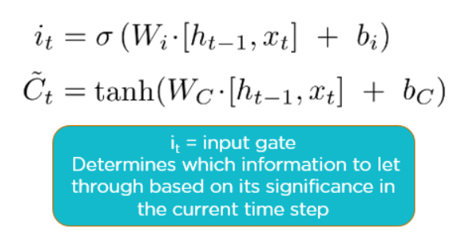
Long Short Term Memory (LSTM)
Step 2:
Step 3: Decide what part of the current cell state makes it to the output
The third step is to decide what the output will be. First, we run a sigmoid layer, which decides what parts of the cell state make it to the output. Then, we put the cell state through tanh to push the values to be between -1 and 1 and multiply it by the output of the sigmoid gate.
Image & Content: https://www.simplilearn.com/tutorials/deep-learning-tutorial/rnn#why_recurrent_neural_networks

Slide 21
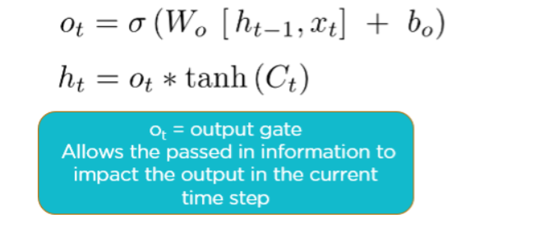
Long Short Term Memory (LSTM)
Step 3: Decide what part of the current cell state makes it to the output
Applications of LSTM include:
Robot control
Time series prediction
Speech recognition
Rhythm learning
Music composition
Grammar learning
Handwriting recognition
Image & Content: https://www.simplilearn.com/tutorials/deep-learning-tutorial/rnn#why_recurrent_neural_networks

Slide 22
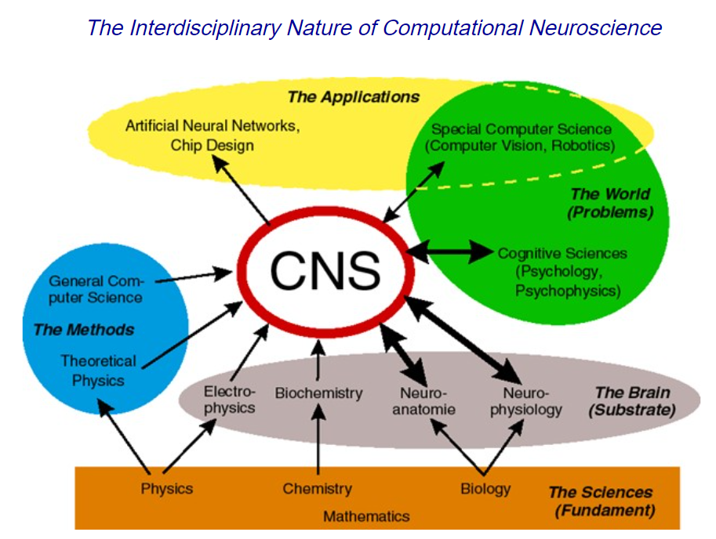
Computational & Artificial Neuro Science
Computational neuroscience is the field of study in which mathematical tools and theories are used to investigate brain function.
The term “computational neuroscience” has two different definitions:
1. using a computer to study the brain
2. studying the brain as a computer

Slide 23
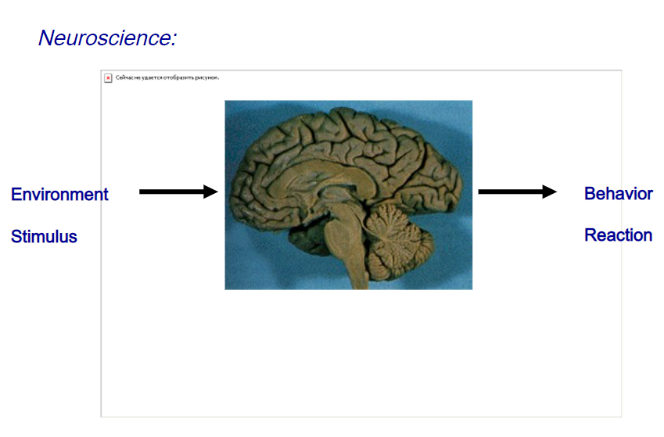
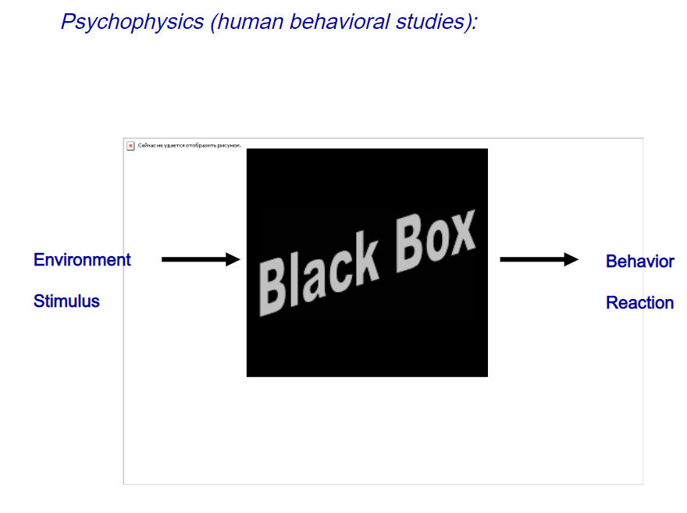
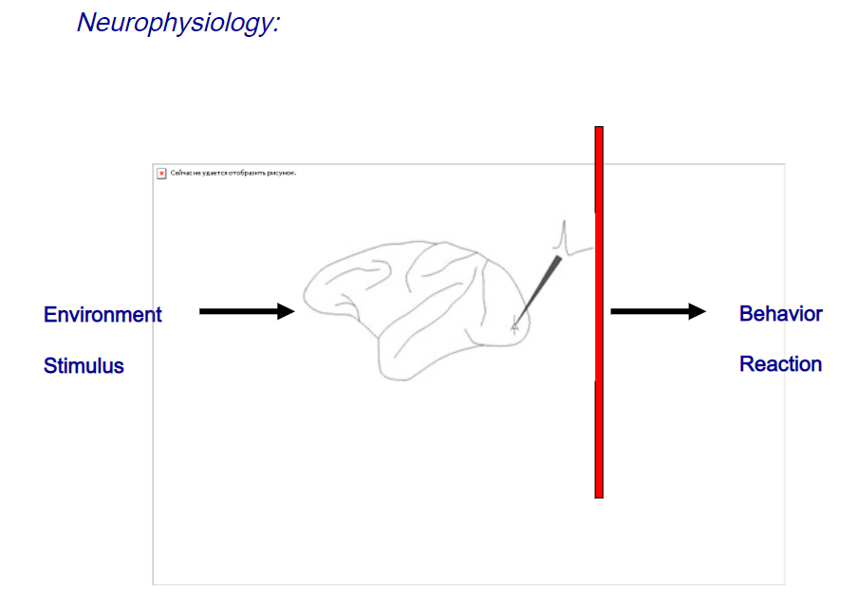
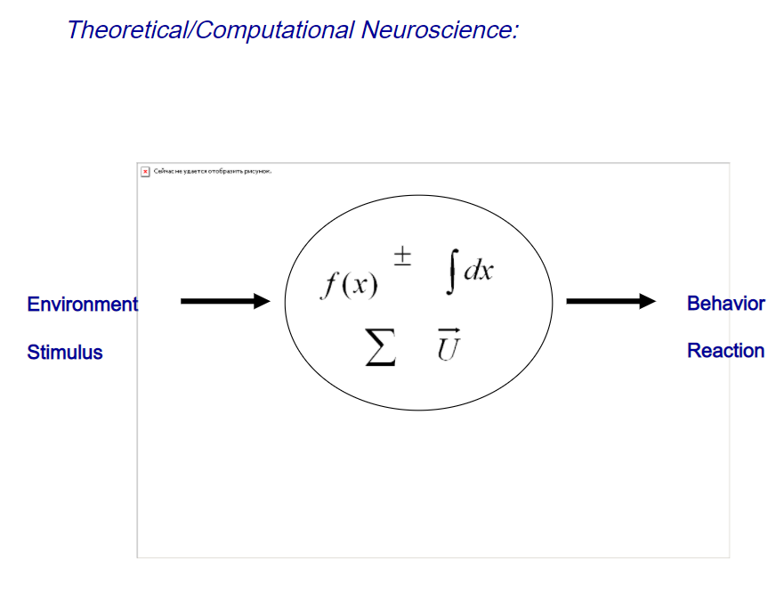
Computational & Artificial Neuro Science

Slide 24
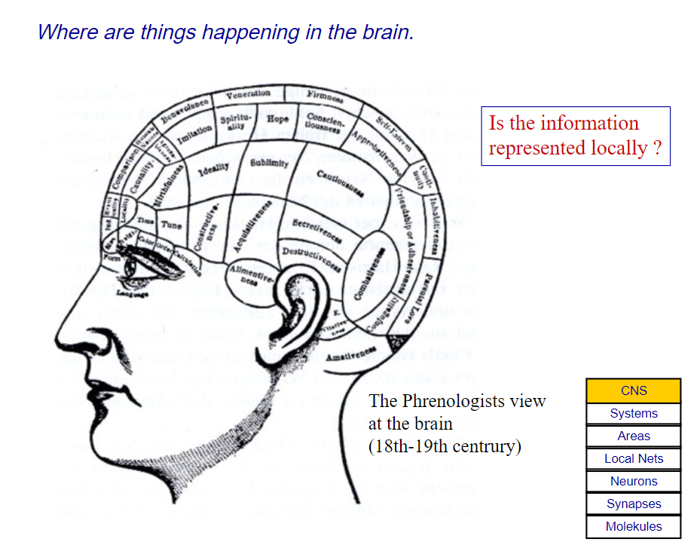
Computational & Artificial Neuro Science

Slide 25
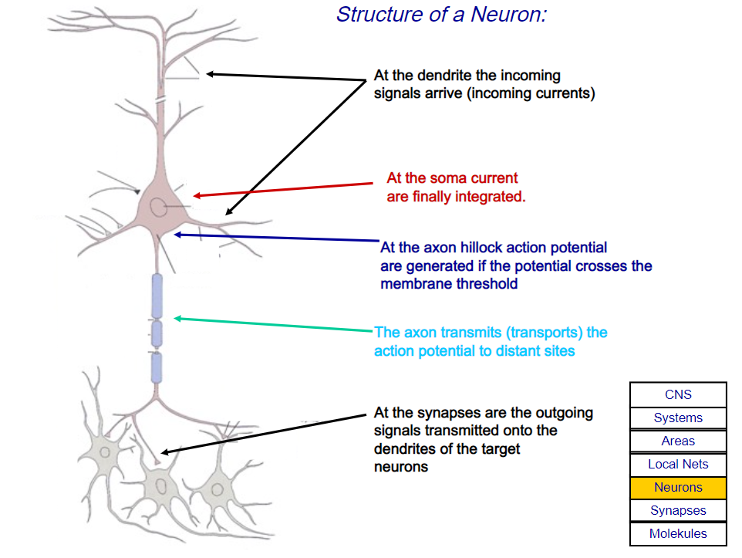
Computational & Artificial Neuro Science

Slide 26
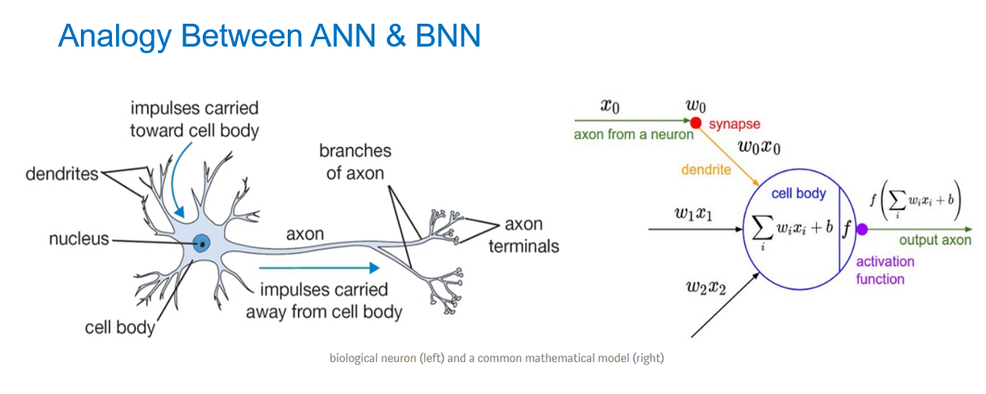
Computational & Artificial Neuro Science

Slide 27
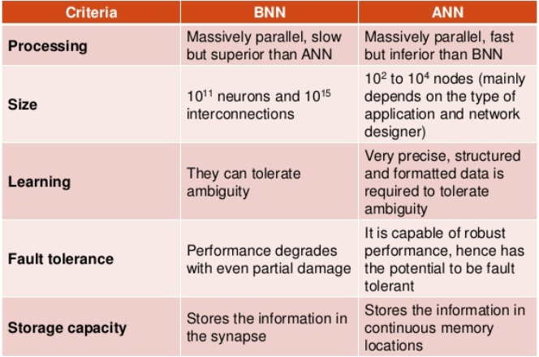
Computational & Artificial Neuro Science

Slide 28
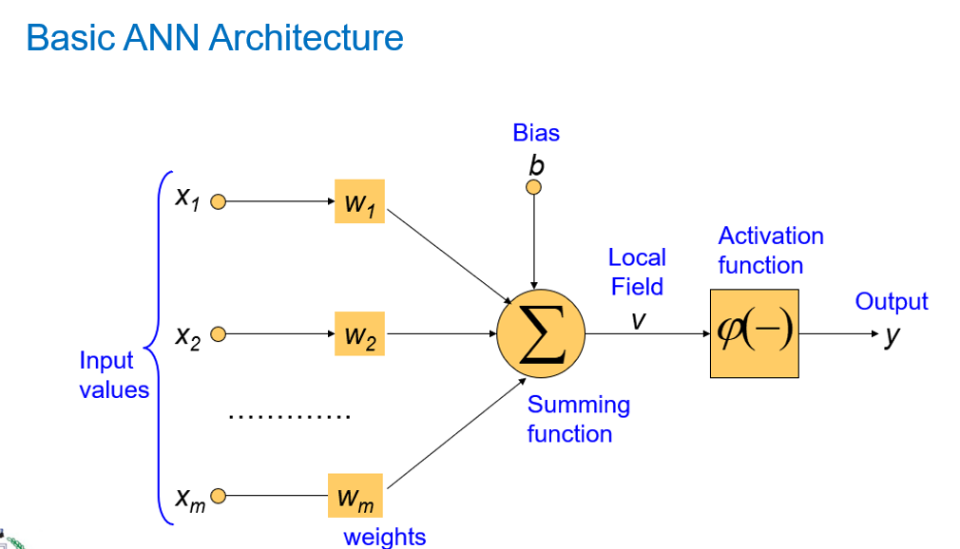
Computational & Artificial Neuro Science

Slide 29
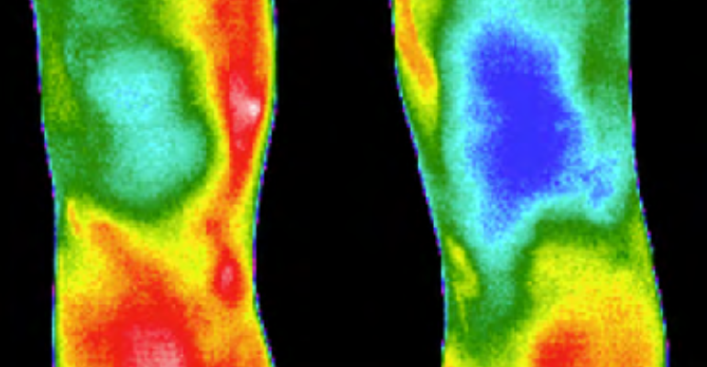
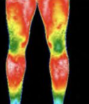
Application of Deep Learning Neural Network- Joint Detection
Rheumatoid Arthritis Present
DLNN MODEL
Rheumatoid Arthritis Absent
Image & Content Source: https://www.researchgate.net/figure/Infrared-image-from-the-anterior-view-of-the-knees-TRIATHLON_fig2_221924974

Slide 30
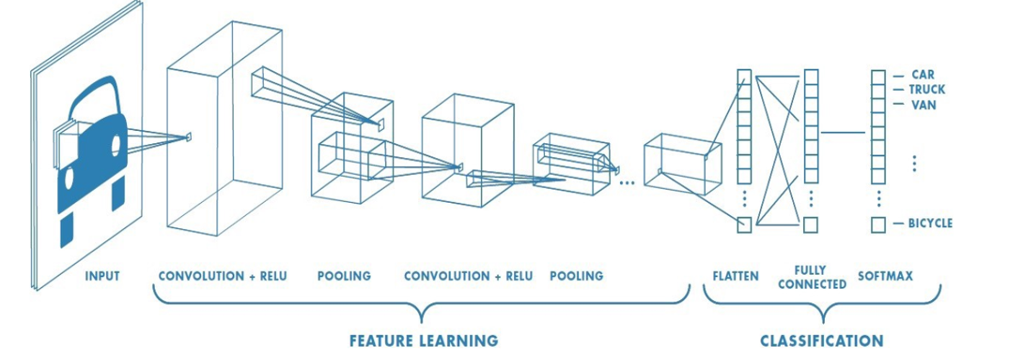
Application of Deep Learning Neural Network- Joint Detection
Image & Content Source: https://www.researchgate.net/figure/Infrared-image-from-the-anterior-view-of-the-knees-TRIATHLON_fig2_221924974

Slide 31
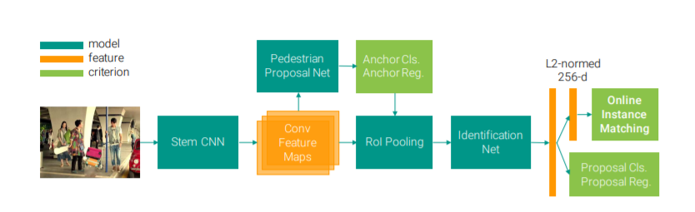
Application of Deep Learning Neural Network- Joint Detection
For Detection of Pedestrian
Image & Content Source: https://openaccess.thecvf.com/content_cvpr_2017/papers/Xiao_Joint_Detection_and_CVPR_2017_paper.pdf

Slide 32
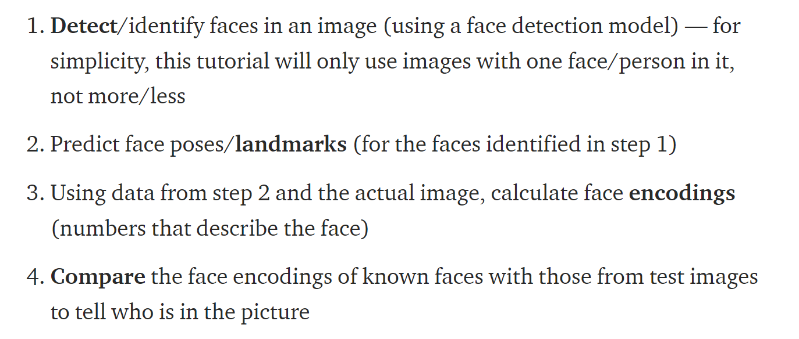
Application of Deep Learning Neural Network- Face Recognition
Image & Content Source: https://towardsdatascience.com/facial-recognition-using-deep-learning-a74e9059a150#

Slide 33
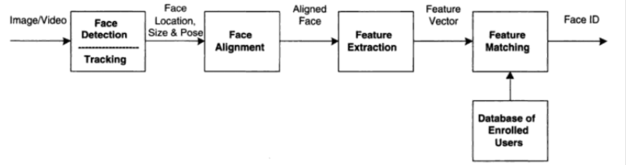
Application of Deep Learning Neural Network- Face Recognition
Image & Content Source: https://machinelearningmastery.com/introduction-to-deep-learning-for-face-recognition/

Slide 34
Application of Deep Learning Neural Network- Object Recognition
Clear;
Load pathToPetFaces.mat;
Petds=image datastore(pathToPetFaces,”IncludeSubFolders”,true);
Load petGT.mat;
Fn = petGT.ImageFilename{};
Im=imread(fn);
Imshow(im);
Bbox= petGT.Madeline{1};
Label=‘Madaline’;
Im=insertObjectAnnotation(im,’rectangle’,bbox,label);
Imshow(im);
Opts=trainingOptions(‘sdgm’,’InitialLearnRate’,0.0001,…
‘MaxEpochs’,5,’MiniBatchSize’,1);
Detector=trainFastRCNNObjectDetector(petGT,’alexnet’,opts);
Dogim=imread(‘Ginny43.jpg’)
Imshow(dogim)
[bones,scores,labels]=(detector,dogim)
Image & Content Source: https://machinelearningmastery.com/introduction-to-deep-learning-for-face-recognition/

Slide 35
Application of Deep Learning Neural Network- Object Recognition
For k=1:length(labels)
Label{str}=[char(label),’:’,num2str(scores)]
Detectedim=InsertObjectAnnotation(dogmim,’rectangles’,bboxes,labelstr);
Imshow(detectedim)
Image & Content Source: https://machinelearningmastery.com/introduction-to-deep-learning-for-face-recognition/

Slide 36

Dr. V. Vedanarayanan B.E., M.E., PhD
Assistant Professor, Department of ECE,
School of Electrical and Electronics
Sathyabama Institute of Science and technology
Vedanarayanan.etc@sathyabama.ac.in
This Photo by Unknown Author is licensed under CC BY

